Slide 1
The Linux Command Line Chapter 2
Manipulating Files And Directories
Prepared by Dr. Reyes, New York City College of Technology

Slide 2
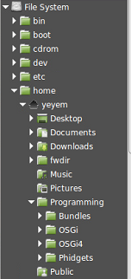
Filesystem Tree
Linux uses hierarchical directory structure
Tree-like structure
Root – First directory
Drives are not separate trees, instead they are mounted
You can see the files and the parent of the current directory
Each user account is given its own home directory

Slide 3

Commands for Directories
pwd - print working directory

Slide 4

Commands for Directories
ls – lists the files and sub-directories in the current working directory

Slide 5

Commands for Directories
cd – change to the specified directory

Slide 6


Special Parameters for Directories
Special parameters
. (dot) – current directory
.. (double dot) – parent directory
- (dash) – changes to the previous working directory
~ (tilde) – changes to your home directory
~username – changed to home directory of username
Examples:

